Slide 1
POWER BI PRESENTATION
BY ANKIT SHRIWAS
DA/DS 24
PITCH PERFECT ANALYSIS

Slide 2
INTRODUCTION
metrics such as match outcomes, player performances, and team statistics across different seasons and cities. It uses various visualizations to showcase trends in player of match awards, team success rates, target runs, and geographic distributions, offering insights into the dynamics of cricket matches.

Slide 3
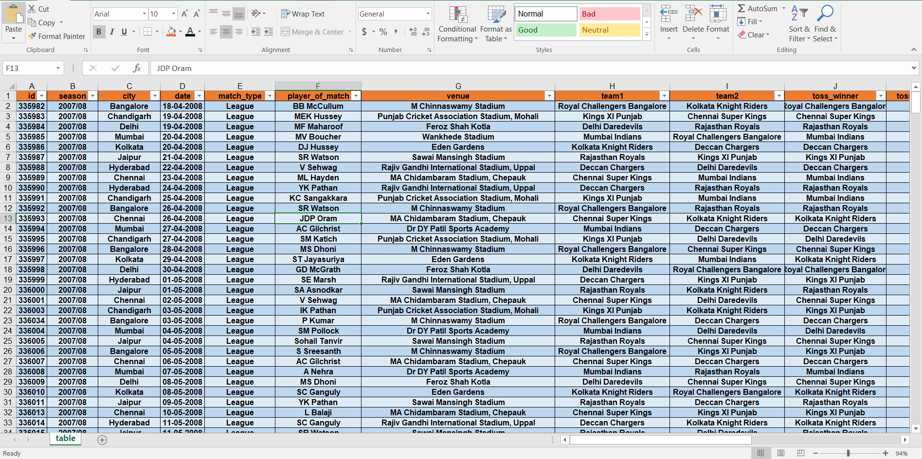

Slide 4
OVERVIEW
Play of Match by team1
Season By Winner
City by Play of Match
Target by Date and Team
Team by Winner
Super over By Result
Date by city and Team

Slide 5
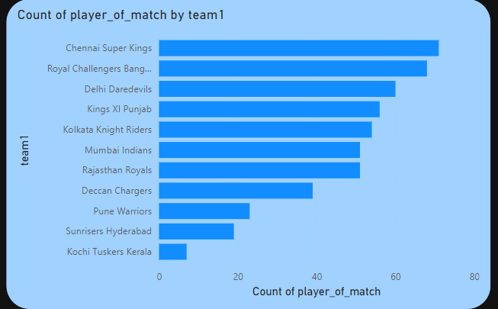

Slide 6
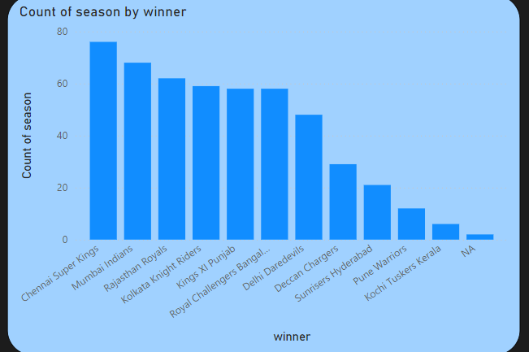

Slide 7
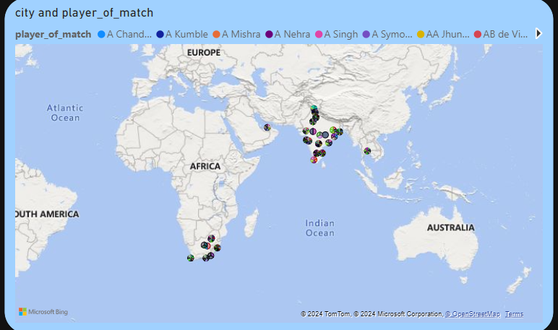

Slide 8
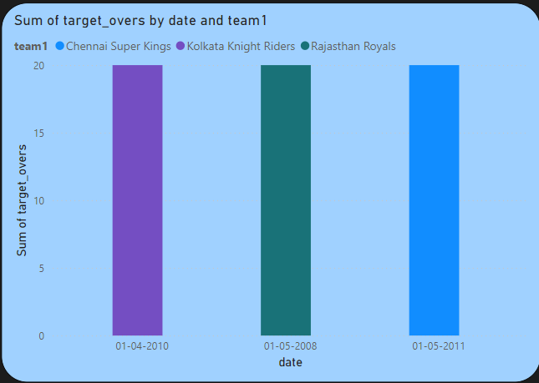

Slide 9
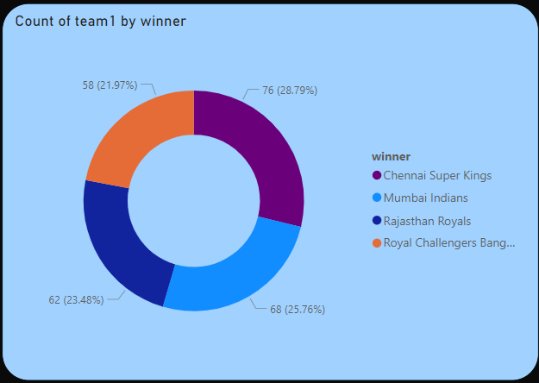

Slide 10
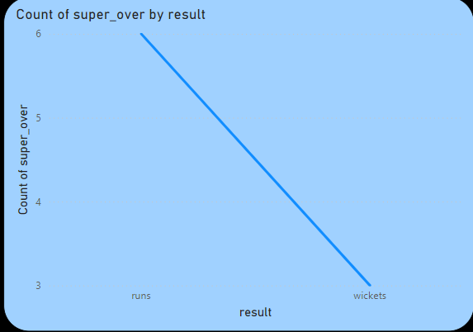

Slide 11
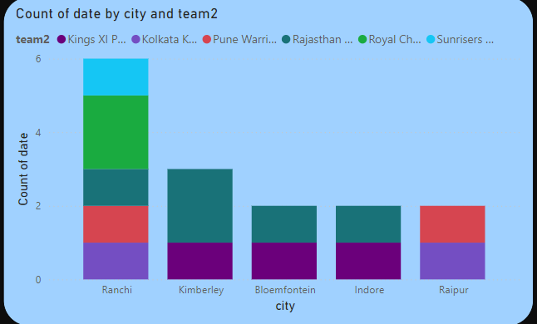

Slide 12
RECOMMENDATION
Performance Analysis:
Highlight which team has won the most tosses ("Count of team1 by toss_winner").
Discuss which player contributed the most to matches won.
Geographical Analysis:
Create a detailed analysis of matches played in different cities to understand venue impact.
Target Runs:
Use the "Sum of target_runs by date" graph to assess whether batting performances have improved or declined over time.
Season Winners:
Showcase which team has consistently performed across seasons, potentially linking it to the "Count of season by winner" data.

Slide 13
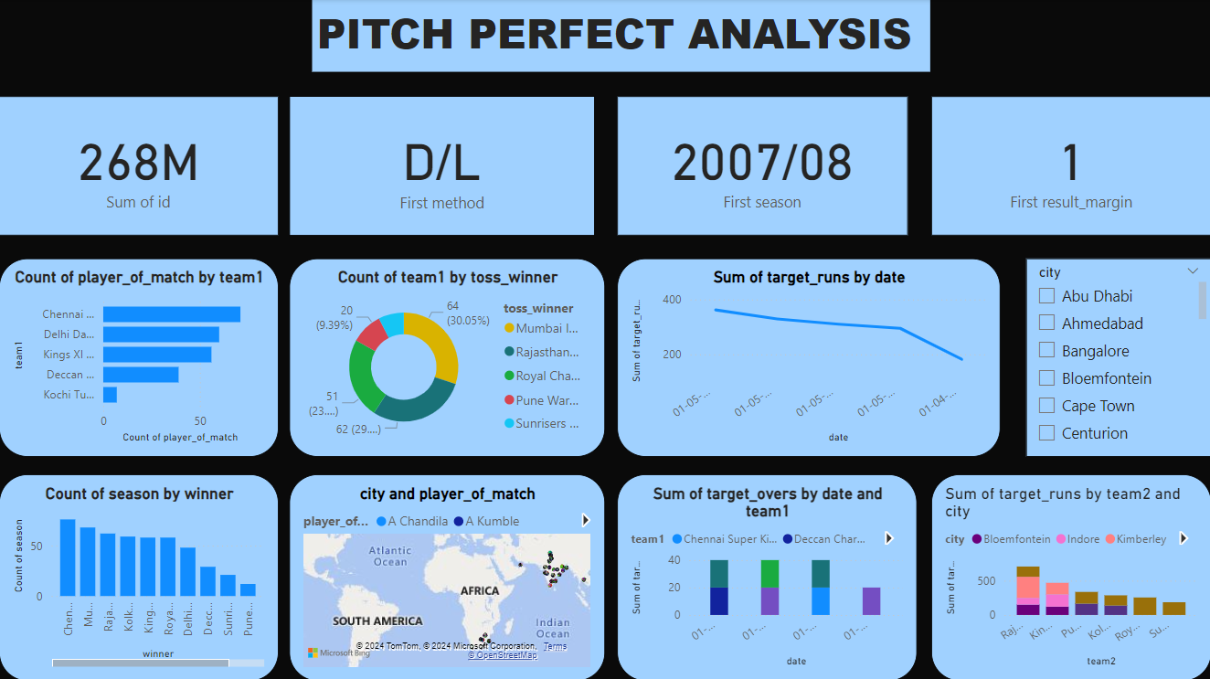

Slide 14
CONCLUSION
In this data, focusing on player performance, team wins, and match statistics across various seasons and cities. Key trends include the dominance of specific teams in player_of_match awards and the influence of toss winners on match outcomes. Target runs show a gradual decrease over time, indicating evolving match strategies or conditions. The geographic spread highlights significant cricket activity across multiple cities, but more detailed insights could enhance understanding. Overall, the data reveals useful patterns in match results and team performance.

Slide 15
THANK YOU

